Slide 1
ICT 2205 Coursework Part 2
Group Members: Ong Chen Yi 1902189 Koh Kai Quan 1902115 Zulfadli Bin Johari 1902147 Chua An Rong Aaron 1902146 Koh Jie Ming Benjamin 1902181

Slide 2
Content
Background
Common Known Attacks
Security Goals
Dependencies
Design
Video Demonstration
Protocol / Schemes
Notes:
Content page for long report (Skipped for short presentation)

Slide 3

Background
Communication between people, especially regarding to sensitive information, is always a major concern. Thus, users are seeking for a secure with low overhead cost method for a private communication channel that is essential when dealing with sensitive information (E.g, Business Communication). Due to many possible form of attacks on the raise over the internet. For example, the possible risk of a Man in the middle (MITM) attack that could steal/alter data
What is Cryptochat?
Decentralized End to End Encrypted (E2EE) Web Chat Application
Private and Secure Communication Between 2 Users
Confidentiality, Integrity, Authenticity

Slide 4
Security Goals
Confidentiality
Integrity
Authenticity
Non-repudiation
Perfect Forward Secrecy
Notes:
Diagram of program, architectural

Slide 5
Design

Slide 6
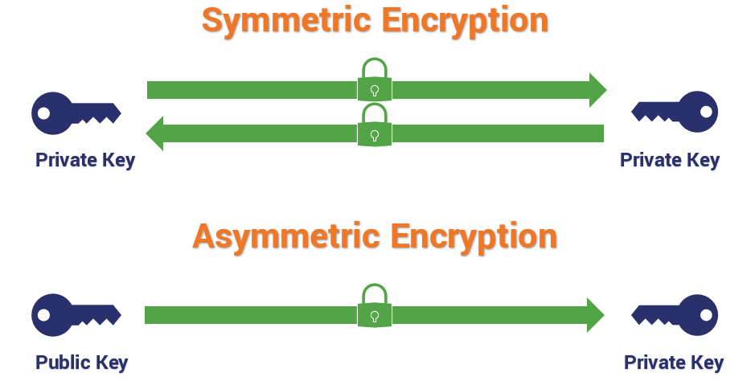
Hybrid Cryptography
Hybrid Cryptography
Common hybrid cryptography uses asymmetric keys to send symmetric keys and other contents to recipients and uses symmetric encryption for messages to achieve faster speed
In this case, Cryptochat’s modified cryptographic scheme offers higher security sacrificing speed by encrypting the symmetric ciphertext with asymmetric encryption
Notes:
Web Application Security Goals Achieved via Key Derivation Function and HMAC, Components of what and why it was used

Slide 7
Multiple Encryption
Multiple encryption
Cascading the encryption offers twice the security but is twice as slow. It slows down the time taken for an attacker to perform a brute force attack
1st symmetric encryption uses a key that changes every round trip with a Salt value of 32 bytes which is almost similar to inserting a 32-character password as input entropy every message exchange (AES-OFB)
Similarly, during the 2nd asymmetric encryption, only the recipient holds the private key required to decrypt the message. Therefore, it is computationally infeasible to derive the private key value used for decryption (ECIES)
Notes:
Higher security at the expense of speed.

Slide 8
Authenticated Encryption
Authenticated Encryption (AE) with Associated Data
A form of encryption which simultaneously assure the confidentiality and authenticity of data.
The approach adopted is:
Encrypt-then-Mac (EtM) with HMAC - SHA 256
The plaintext is first encrypted, then a MAC is produced based on the resulting ciphertext. The MAC is unforgettable given that the input entropy is generated with the shared secret from ECDH key exchange.
This is semantically secure because the cryptographic algorithm uses asymmetric encryption, generates a random IV and does not reuse them for symmetric encryption
Notes:
Authenticated encryption schemes can recognize improperly-constructed ciphertexts and refuse to decrypt them

Slide 9
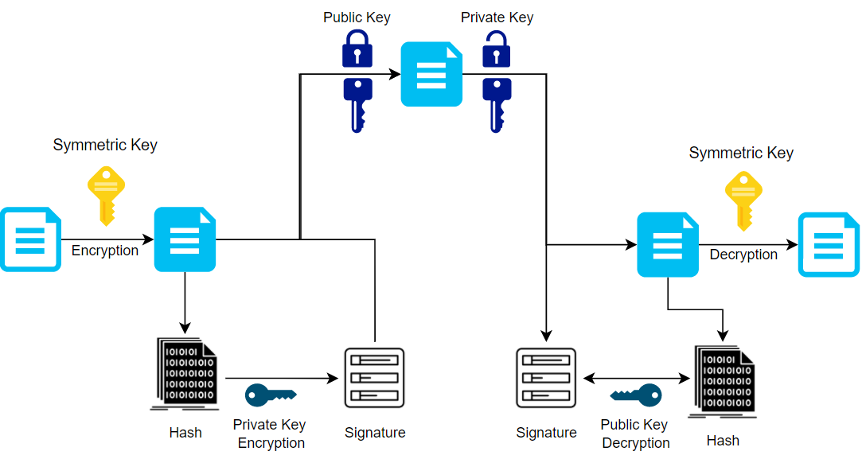
Architectural Diagram (Message Exchange)
Cryptochat: A Web Chat Application
The main function of the Web Chat Application is to provide a End-to-end Encryption communication channel that serves all security goals
Notes:
Architectural Diagram of Program

Slide 10
Protocol / Schemes

Slide 11
ECDH
(Key Exchange)
Elliptic-Curve Diffie–Hellman
A key agreement protocol that allows two parties to exchange key securely using secp256k1
Use in the application to perform key exchange for initial session establishment to generate shared secret key K and ephemeral key pair exchange use in ECIES
Notes:
Keep
Gg idk if it’s a bit too long, i might have to edit again
E(S(H(ss + id))) for establishing initial session room id and shared secret k is not being sent over because the other party should know
E(E(m), S(H(E(m) + id)))
If signature verification failed, both parties will generate a private public key pair each and redirect to a new separate room
In this program ECDSA is used in the establishment of initial session, and also when message is sent and received.

Slide 12
CSPRNG
(Key generation)
Key Generation
Cryptochat uses the node.js library crypto.randomBytes(size)
/dev/urandom for Unix, and BCryptgenrandom for windows that presumes security
Bcryptgenrandom passes the NIST 800-22 special publication for statistical randomness test
Notes:
cryptographically secured number that presumes security and avoid security by obscurity by providing backtracking and prediction resistance.
Bcryptgenrandom passes the NIST 800-22 special publication for statistical randomness test and an attacker should not be able to predict future values based on only observing the entropy source.

Slide 13
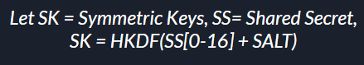
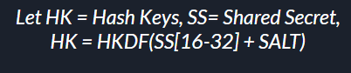
HKDF
(Key Derivation)
Extract-and-Expand Paradigm Implementation
Uses HKDF that takes in a different CSPRNG 32-bytes input entropy every message round trip to generate secret keys for symmetric encryption
Generate hash key for HMAC-sha256 to produce hash
This ensures the key are uniformly distributed and unbiased for encryption/decryption
Notes:
Keep

Slide 14
AES-OFB
(Confidentiality)
What is it? Confidentiality
Change Plaintext to Ciphertext Unreadable text to users Prevents cipher-only attacks
Symmetric Encryption (AES-OFB)
Encrypt message with SK and IV (PRNG)
Let CT = Ciphertext,
CT = AES-OFB-E (message, SK, IV)
Symmetric Decryption (AES-OFB)
Decrypt message with SK and IV
message = AES-OFB-D (CT, SK, IV)
Notes:
Cipher only attacks from frequency analysis

Slide 15
ECIES
(Confidentiality)
What is it?
Change Plaintext to Ciphertext Unreadable text to users Based off hybrid encryption scheme for crypto standards SECG SEC-1, ISO/IEC 18033-2, IEEE 1363a and ANSI X9.63
Asymmetric Encryption (ECIES)
Generate ephemeral public/private keys (ePK, ePrK)
Encrypt other contents that is required to be sent over with receiver’s public key (rPK)
Let CT = Ciphertext
CT = ECIES-E (content, rPK, ePrK)
Asymmetric Decryption (ECIES)
Uses ephemeral public key (ePK) and receiver’s private key (rPrK) to decrypt content
Content = ECIES-D (CT, rPrK, ePK)
Notes:
It produces an ephemeral key that will perform ECDH to generate the shared secret with recipient public key which will use different components of the shared secret K to perform an AES-CBC encryption. Even though it seems to be using a symmetric encryption, on a higher level, the recipient private key is still required to decrypt the message with the ephemeral public key, therefore compromising speed while offering higher security with PKI.

Slide 16
ECdsa
(Authenticity & Non-repudiation)
Elliptic Curve Digital Signature Algorithm
Authenticity to ensure message comes from specific entity Non-repudiation so that senders cannot deny sending the message
Sign (ECdsa-sign)
Pad content to fixed size
Signs contents that is required to be sent over with sender’s private key (sPrK)
Only sender holds the private key, content signed cannot be refute
Let SC = Signed Content
SC = ECdsa(pad(content), sPrK)
Verify Signature (ECdsa-verify)
Verify the signature with the content and sender’s public key (sPK)
verify = ECdsa(SC, sPK)
Notes:
Keep
Might have to change formula?

Slide 17
HMAC - SHA 256
(Integrity & Authenticity)
What is it?
Hashing ensures that the message has not been tampered or altered appended with the recipient ID to ensure message integrity and prevent replay attack
Hashing - HMAC-sha256
Passes the Hash key (HK) with content
Uses Encrypt-then-MAC (EtM)
Appended recipient ID with Encrypted Message to prevent replay/interleaving attack
Let HC = hashed content
HC = HMAC-sha256(E(msg) || IDr, HK)
Notes:
Keep

Slide 18
Perfect Forward Secrecy
What is it?
Decrypting current ciphertext will not reveal previous messages
How?
Symmetric Encryption
Generation of secret keys include a Salt that will never be reused every message round trip
Ensures that every message is decrypted with a different secret key
Asymmetric Encryption
Generate ephemeral keys (one-time keys) that will be discarded upon usage every message roundtrip
Ephemeral keys are never reused
Notes:
Keep

Slide 19
Commonly Known Attacks

Slide 20
Commonly Known Attacks
Prevent Brute force
256-bit key size that is computationally infeasible to derive
Prevent Replay/Interleaving attacks
Appended ID with the message before hashing with HMAC-sha256
Prevent MITM
Through mutual authentication, encrypted with cascading encryption (Eavesdrop)
Prevent cipher-only attacks
Uses AES-OFB to prevent repeated common blocks and uses, uses asymmetric encryption
Prevent chosen ciphertext attacks
Uses Encrypt-then-MAC scheme with AES-OFB and HMAC-sha256 to provide authenticity using secret hash key
Notes:
Keep

Slide 21
Detailed Program Flow

Slide 22
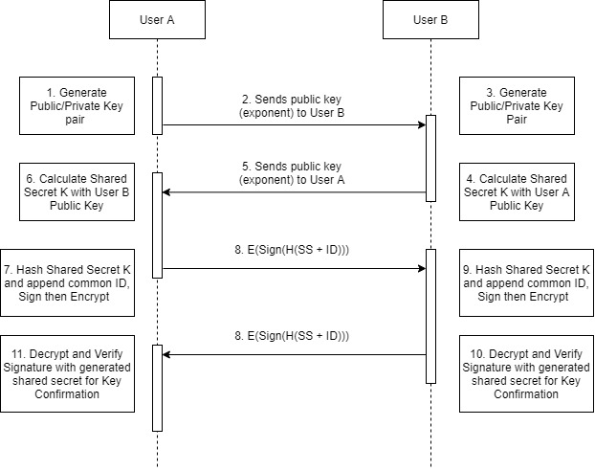
Initial Session Establish
Session Key establishment
Both user exchange public key exponent and calculate shared session secret key K using Elliptic Curve Diffie Hellman (secp256k1)
Notes:
Diagram of program, architectural

Slide 23
Mutual Authentication (Key confirmation)
Mutual Authentication
Key confirmation by hashing key K appended with agreed room ID, sign with sender’s private key and encrypt with recipient public key
Upon receiving message, decrypt and verify signature with own key K appended with agreed room ID
Notes:
Diagram of program, architectural

Slide 24
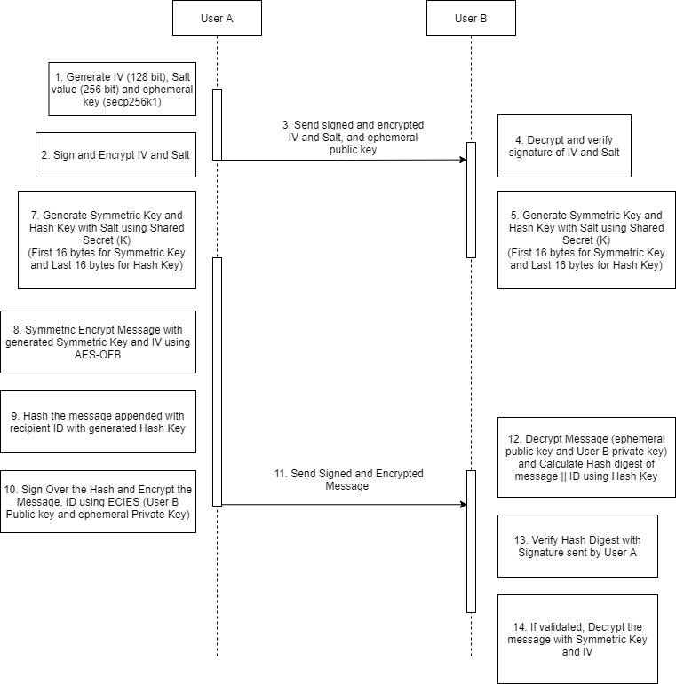
Message Exchange
Sender Generate 128-bit IV, 256-bit Salt and ephemeral key use for symmetric and asymmetric encryption respectively every message round trip
Sign with sender’s public key and encrypt with recipient public key before sending contents
Notes:
Diagram of program, architectural

Slide 25
Message Exchange
Recipient receive, decrypt with private key and validate signature with sender’s public key
Both sender and recipient generate symmetric key and hash key using Salt and IV
Notes:
Diagram of program, architectural

Slide 26
Message Exchange
Sender performs AES-OFB symmetric encryption over message using symmetric key and IV
Sender generates a hash digest of encrypted message appended with recipient ID, H(E(msg) + id)
Sender signs over the hash and encrypt the message, id and hash using ECIES, using recipient public key and ephemeral private key
Notes:
Diagram of program, architectural

Slide 27
Message Exchange
Recipient receives the message and performs asymmetric decryption with private key and ephemeral public key
Calculates the hash digest using decrypted message appended with own id
Validate the signature against the signed hashed message appended with recipient ID by sender
Once validated, symmetric decrypt the message

Slide 28
Dependencies
Crypto-JS
Futoin-HKDF
Eccrypto Library
AES-JS
Dependencies
Buffer-from
Deasync
Web API Javascript
Notes:
Keep

Slide 29
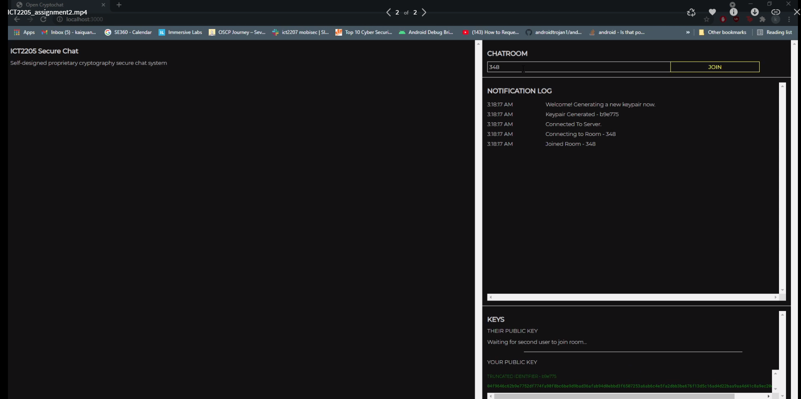
Video Demonstration
Notes:
Video: https://mega.nz/file/SaBzwKpb#qkVVhM2VL8UsproMuNrc8RRdfVs4Fj8364GItZwQgmU
Web Chat Application: https://cryptochatwebapp.azurewebsites.net/

